Slide 1
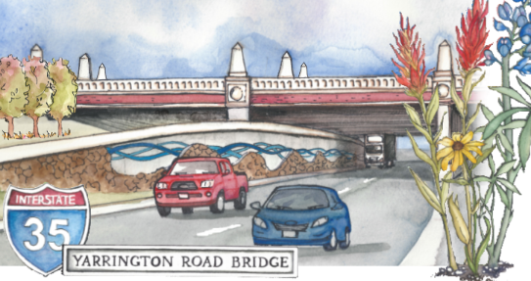
David Dennis, CSHO, SSH
Director of Safety, OHL USA

Slide 2
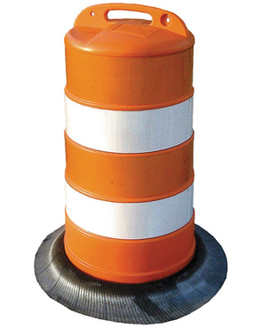
Each year in Texas, there are approximately 15,000 crashes and more than 100 people killed in highway construction and maintenance zones
Motorists traveling through work zones make up the majority of fatalities. The two leading factors for work zone crashes are failure to control speed and driver inattention.
In Texas, there can be as many as 2,500 active work zones at any given time. There are currently 20 active work zones along Interstate 35 in Texas, encompassing 109.6 miles from north to south.

Slide 3
Driver Safety
Slow down and always follow posted work zone speed limits. Speeding is one of the major causes of work zone crashes. Remember, traffic fines double in work zones.
Pay attention. Workers and heavy equipment may only be a few feet from passing vehicles.
Be patient. Delays from highway construction can be frustrating, but it only takes a few extra minutes to slow down for a work zone.
Plan ahead. Leave a few minutes early when traveling through a work zone in order to reach your destination on time.

Slide 4
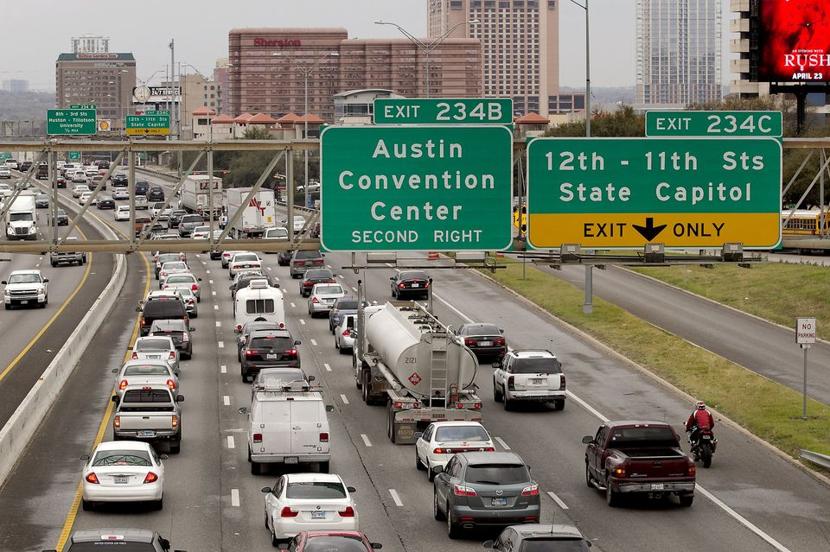
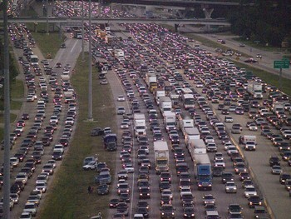
More Work to Do
Work zone safety and awareness is critical, both for drivers and the men and women who work on our highways. TxDOT continues to work on increased safety measures and public outreach efforts to educate motorists about the dangers of work zones, but we need your help.
Austin IH 35
Houston 290

Slide 5
Work Zone
A Work Zone is an area of roadway activities with…
Construction
Maintenance
Utility work
A Work Zone is typically marked by…
Signs
Channelizing devices
Barriers
Pavement markings
Work vehicles

Slide 6
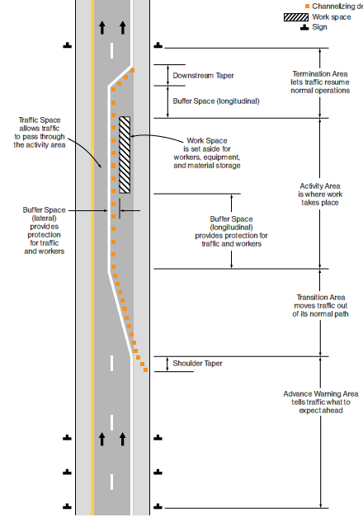
Work Zone
Advance Warning – tells traffic what to expect ahead Shoulder Taper
Transition Area – moves traffic out of its normal path
Activity Area – this is where the work takes place
Buffer Space – provides protection for traffic and worker
Work Space – this is for workers, equipment, and material
Traffic Space – allows traffic to pass by the active area
Termination Area – allows traffic to resume normal operations
Buffer Space – provides protection for traffic and workers
Downstream Taper – where traffic resumes normal operations

Slide 7
Purpose of Temporary Traffic Control Devices
Provides a Positive Barrier for Construction Works
Influences Drivers Perception of Risk
Promotes Highway Safety
Provides Information on Potential Hazards
Minimizes Aggressive Behavior of Drivers
Assists in Orderly Movement
Notify Road Users of Regulations
Minimize the Occurrences of Crashes

Slide 8
Work Zone Awareness Week
Each year TxDOT collaborates with the Federal Highway Administration and other transportation partners to observe National Work Zone Awareness Week.
Be responsible when you enter a work zone safety.
Remember - Slow down, Pay attention, Be patient
Plan ahead, Don’t Text or Talk when driving though a Work Zone…Be safe. Drive smart. Your life depends on it.

Slide 9
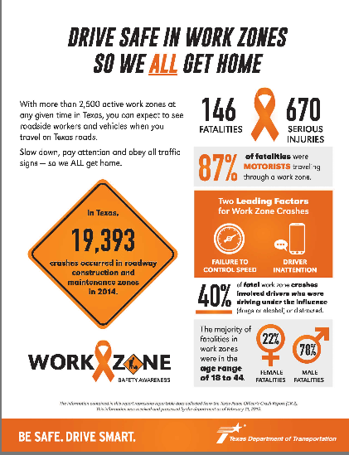
Work Zone Awareness Week
Thank you for your attention here and on the road
Please take handouts and pass the message on
For more info contract:
David Dennis, CSHO, SSH
Director of Safety, OHL USA
ddennis@ohlusa.com

